Slide 1
Learning Task Grouping and Overlap in Multi-Task Learning
Yijun Liu
Department of Computer Science
University of Wyoming
Zhang, Yu, and Qiang Yang. "A survey on multi-task learning." arXiv preprint arXiv:1707.08114 (2017).
Kumar, Abhishek, and Hal Daume III. "Learning task grouping and overlap in multi-task learning." arXiv preprint arXiv:1206.6417 (2012).

Slide 2
Overview of Multi-Task Learning
Introduction
Related Work
Learning Task Grouping and Overlap
Experiments and Conclusion

Slide 3

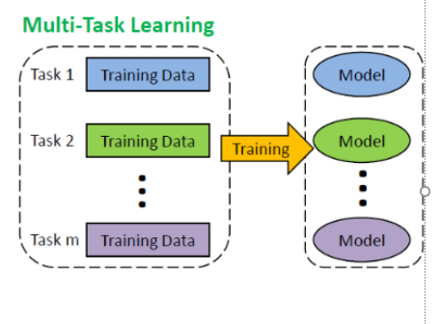


Overview of Multi-Task Learning
Traditional supervised learning methods make prediction for each single task.

Slide 4
Multi-Task Learning
Sometimes, for multiple learning tasks, all of them or at least a subset of them are assumed to be related to each other.
In this case, it is found that learning these tasks jointly can lead to much performance improvement compared with learning them individually.
Multi-Task Learning:
Given m learning tasks {T_{i} | i=1,…,m } where all the tasks or a subset of them are related, multi-task learning aims to help improve the learning of a model for T_{i} by using the knowledge contained in the m tasks.

Slide 5
How to share?
Since tasks are related, it is reasonable to assume that different tasks share a common feature representation based on the original features.
feature
parameter
Impose various types of relations on tasks with regularization of parameters
instance
Find out instances in the task T_{i} , which can be used by another task T_{j} (j≠i) .

Slide 6
Introduction
A major challenge in multi-task learning is how to selectively screen the sharing of information so that unrelated tasks do not end up influencing each other.
Sharing information between two unrelated tasks can worsen the performance of both tasks. This phenomenon is also known as negative transfer.
In this paper, two tasks can have full, partial or no overlap, which is determined by number of basis tasks they share.
Kumar, Abhishek, and Hal Daume III. "Learning task grouping and overlap in multi-task learning." arXiv preprint arXiv:1206.6417 (2012).

Slide 7
Related Work
Most methods work on the assumption that all tasks are related (Evgeniou & Pontil, 2004; Ando & Zhang, 2005; Argyriou et al., 2008a; Rai & Daum´e III, 2010).
Some methods assume that tasks can be grouped in clusters (Bakker & Heskes, 2003; Jacob et al., 2008; Xue et al., 2007; Zhou et al., 2011).
Other methods assume that there is one group of related tasks and a small number of outlier tasks that are not related to any task in the pool (Yu et al., 2007; Chen et al., 2011)
Another common assumption is that task parameters lie in a low dimensional subspace that captures the predictive structure for all the tasks (Argyriou et al., 2008a; Liu et al., 2009)
Both these methods assume that groups are disjoint and tasks are either related (within a group) or totally unrelated (in different groups).

Slide 8
Learning Task Grouping and Overlap
Proposed approach as GO-MTL for Grouping and Overlap in Multi-Task Learning.
Suppose we have T tasks and Z_{t} = {(x_{ti}, y_{ti}) : i = 1, 2, . . . ,N_{t}} be the training set for each task t = 1, 2, . . . , T. We get:
W = LS
where L is a matrix of size d × k with each column representing a latent task, and S is a matrix of size k×T containing the weights of linear combination for each task. W is the task weight matrix which is of size d × T , with d being the feature dimension.
d is feature dimension，k is the latent tasks.

Slide 9

Learning Task Grouping and Overlap
If s_{t} denotes the sparsity pattern for task t, our learning cost function is:
where L(·, ·) is the empirical loss function, || · ||₁ is entry-wise L1 norm of the matrix and ||L||_{F} = (tr(LL′))1/2 is the Frobenius norm of matrix L. The parameter μ controls the sparsity in S. The penalty on the Frobenius norm of L regularizes the predictor weights to have low L2 norm and avoids overfitting.

Slide 10

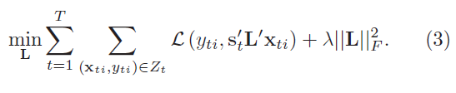
Learning Task Grouping and Overlap
We adopt alternating optimization strategy that converges to a local minimum. For a fixed L, the optimization function can be decomposed as
For a fixed S, the optimization problem reduces to following:

Slide 11
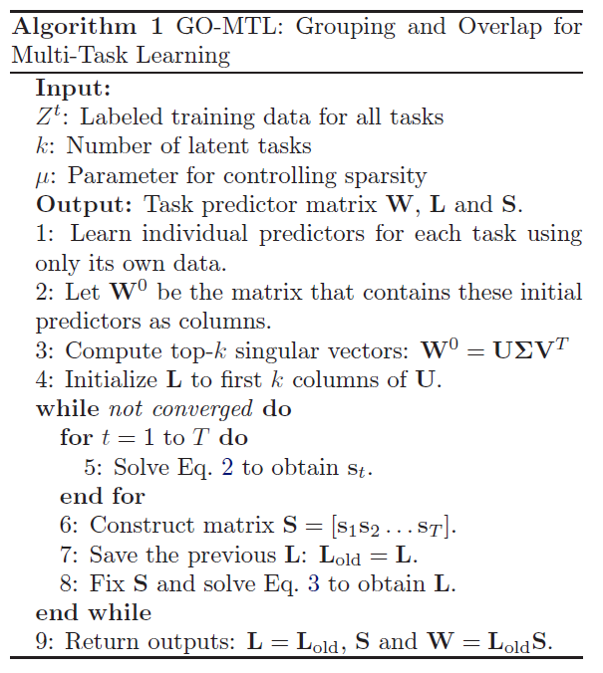
Linear Mixed Models (LMMs)
Algorithm 1 outlines the steps and initialization procedure for our approach.

Slide 12




Regression: Squared Loss
The matrix form of Eq.1 can be written as
For a fixed L, the squared loss function
To optimize for s_{t} using two-metric projection method.

Slide 13
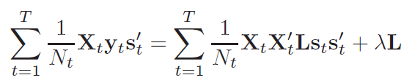
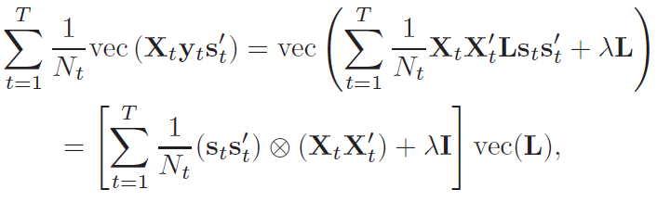
Regression: Squared Loss
For a fixed S, equating the gradient of Eq. 4 to zero gives
This is a linear equation in L. To solve this, applying vectorization operator on both sides
It can be solved using LU decomposition or by iterative methods.

Slide 14
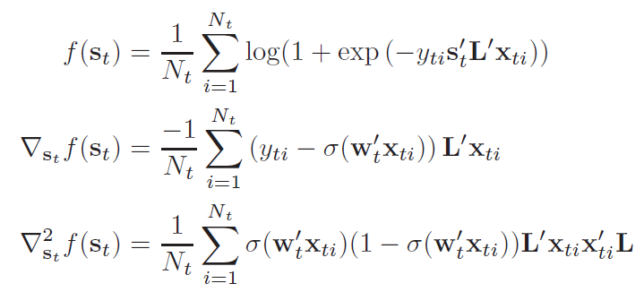
Classification: Logistic Loss
For logistic loss function, which is given as
For a fixed L
Using two-metric projection method to update the S_{t}

Slide 15
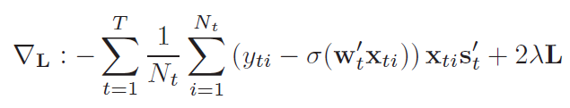
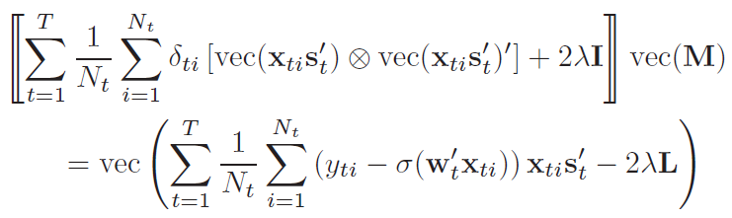

Classification: Logistic Loss
For a fixed S, we give Newton-Raphson update here.
For Newton-Raphson update, we use Taylor series expansion up to second order around L, making use of directional first and second derivatives. The step direction M is obtained by solving the following system of linear equations:
The Newton-Raphson update is then carried out by taking a step in this direction. The step size is computed using Armijo rule.

Slide 16
Experiments-Synthetic data 1
We use two synthetic datasets to study our approach. First, we use the synthetic data used in (Kang et al.,2011). This data consists of 20-dimensional feature vectors, three groups of tasks, 15 training points and 50 test points per task. There are 10 tasks in each group whose parameter vectors are identical to each other up to a scaling factor.
No-group MTL (Argyriou et al., 2008a): All tasks are assumed to be related, and the task parameters are assumed to lie in a low dimensional subspace.
• Disjoint-Group MTL (DG-MTL) (Kang et al., 2011): A recently proposed approach that assumes multiple disjoint groups of tasks. Task parameters within a group lie in a low dimensional space.

Slide 17
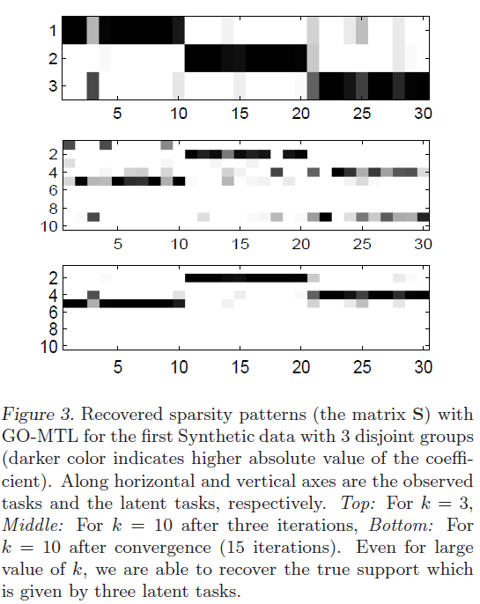
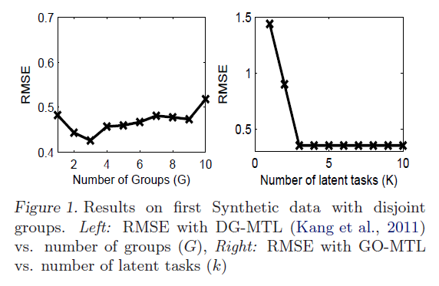
Experiments-Synthetic data 1

Slide 18
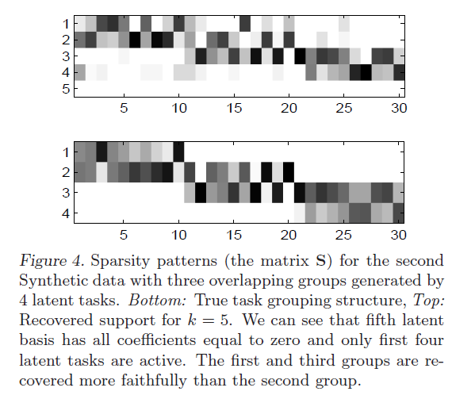
Experiments-Synthetic data 2
We generate a second synthetic dataset to simulate overlap in groups. We retain the previous setting of 3 groups and 10 tasks in each group, but now we allow the groups to overlap in one basis.
First 10 tasks - linearly combining first two latent tasks.
Next 10 tasks - linearly combining second and third latent tasks.
Last 10 tasks - linearly combining of the last two latent tasks.

Slide 19
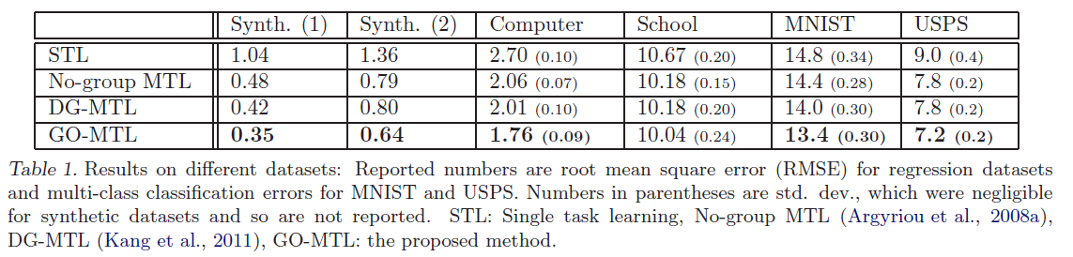
Experiments-Synthetic data + Real datasets

Slide 20
Conclusion
We proposed a novel framework for learning grouping and overlap structure in multi-task learning, where parameters of each task group are assumed to lie in a low dimensional subspace.

Slide 21
Thank you

